Slide 1
UMM Unlearning Knows But Can't Draw: Toward Modality-Selective Concept Suppression in Unified Multimodal Models
2026.04.15
Hayeon Jeong

Slide 2
Table of Contents
Recap: Loss
Experiments
Settings
fixed 3 bundles
safe SAEmnesia top1
safe SAEmnesia top3
Generalization
Show-o
Extension to Image Editing
Datasets

Slide 3


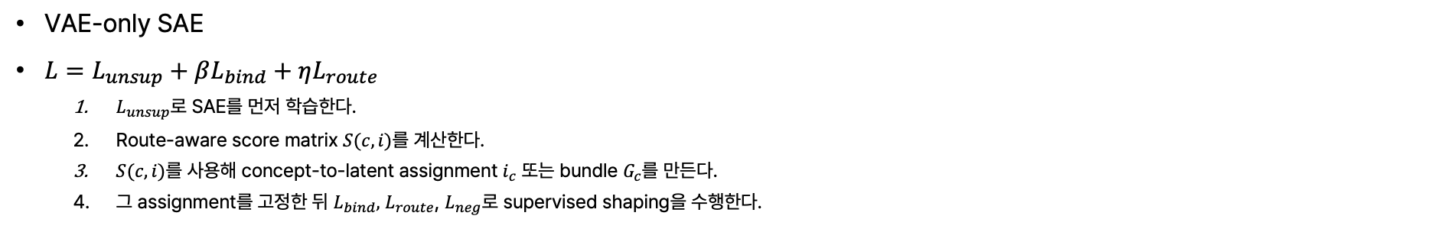






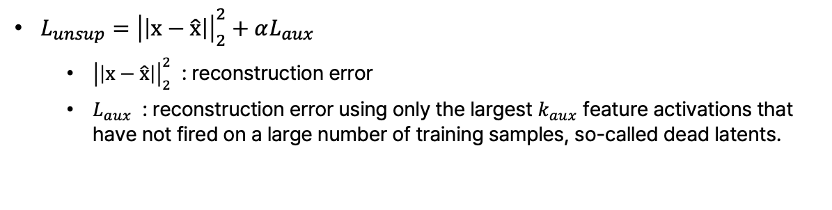


Recap: Loss
$$L=L_{unsup}+βL_{bind}+ηL_{route}$$
Same Sequence (Packed)
[Text Tokens] + [VAE (image) Tokens]
VAE-only SAE
$L=L_{unsup}+βL_{bind}+ηL_{route}$
$L_{unsup}$로 SAE를 먼저 학습한다.
Route-aware score matrix $S(c,i)$를 계산한다.
$S(c,i)$를 사용해 concept-to-latent assignment $i_{c}$ 또는 bundle $G_{c}$를 만든다.
그 assignment를 고정한 뒤 $L_{bind},$ $L_{route}$, $L_{neg}$로 supervised shaping을 수행한다.
X 28
[Text Tokens]
[VAE (image) Tokens]
(Understanding)
$$W^{Q_und}, W^{K_und}, W^{V_und}$$
(Generation)
$$W^{Q_gen}, W^{K_gen}, W^{V_gen}$$
Text Q, K, V
VAE Q, K, V
$L_{unsup}={\left|\left|x−\hat{x}\right|\right|}_{2}^{2}+αL_{aux}$
${\left|\left|x−\hat{x}\right|\right|}_{2}^{2}$ : reconstruction error
$L_{aux}$ : reconstruction error using only the largest $k_{aux}$ feature activations that have not fired on a large number of training samples, so-called dead latents.
Self-Attention
(Understanding)
$${FFN}^{und}$$
(Generation)
$${FFN}^{gen}$$
$$x$$
$$W_{enc}$$
$$z∈ℝ^{114688}$$
$$W_{dec}$$
$$\hat{x}$$
Notes:
- SAE 구조 및 loss 정확히 (L_aux가 실제로 k=64개 말고 0으로 처리하는가?)
- expansion factor를 16으로 해도 56000개가 있는데, 그 중에서 실제로 몇개를 쓰고 있는거임?
- 평균이 아니라... max로 보는게 더 오브젝트 존재 유무 필터링이 더 잘되지 않을까 (style은 mean으로 할 수 있겠지만)
- dog 예시만 먼저 작게 진행 (beagle, poodle 이렇게 아주 간단한, 스타일 변이도 없이 진행하도록)

Slide 4

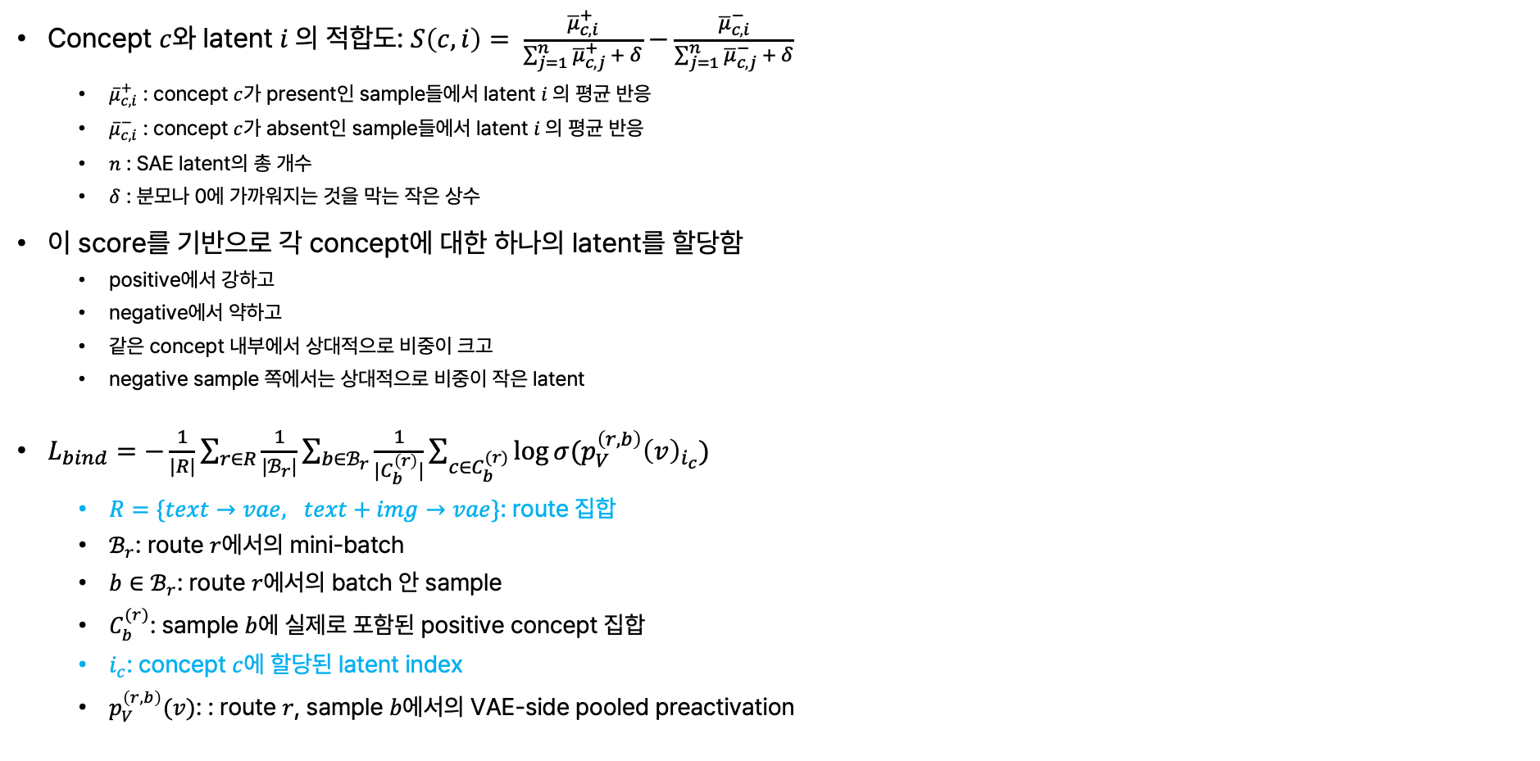
Recap: Loss
$$L=L_{unsup}+βL_{bind}+ηL_{route}$$
Concept $c$와 latent $i$의 적합도: $S\left(c,i\right)= \frac{{\overline{μ}}_{c,i}^{+}}{\sum_{j=1}^{n}{{\overline{μ}}_{c,j}^{+}} + δ}−\frac{{\overline{μ}}_{c,i}^{−}}{\sum_{j=1}^{n}{{\overline{μ}}_{c,j}^{−} + δ}}$
${\overline{μ}}_{c,i}^{+}$ : concept $c$가 present인 sample들에서 latent $i$의 평균 반응
${\overline{μ}}_{c,i}^{−}$ : concept $c$가 absent인 sample들에서 latent $i$의 평균 반응
$n$ : SAE latent의 총 개수
$δ$ : 분모나 0에 가까워지는 것을 막는 작은 상수
이 score를 기반으로 각 concept에 대한 하나의 latent를 할당함
positive에서 강하고
negative에서 약하고
같은 concept 내부에서 상대적으로 비중이 크고
negative sample 쪽에서는 상대적으로 비중이 작은 latent
$L_{bind}=−\frac{1}{|R|}\sum_{r∈R}{\frac{1}{|ℬ_{r}|}}\sum_{b∈ℬ_{r}}{\frac{1}{|C_{b}^{\left(r\right)}|}}\sum_{c∈C_{b}^{(r)}}{\log{σ(p_{V}^{\left(r,b\right)}{\left(v\right)}_{i_{c}})}}$
$R=\{text→vae, text+img→vae\}$: route 집합
$ℬ_{r}$: route $r$에서의 mini-batch
$b∈ℬ_{r}$: route $r$에서의 batch 안 sample
$C_{b}^{(r)}$: sample $b$에 실제로 포함된 positive concept 집합
$i_{c}$: concept $c$에 할당된 latent index
$p_{V}^{\left(r,b\right)}(v)$: : route $r$, sample $b$에서의 VAE-side pooled preactivation
Same Sequence (Packed)
[Text Tokens] + [VAE (image) Tokens]
X 28
[Text Tokens]
[VAE (image) Tokens]
(Understanding)
$$W^{Q_und}, W^{K_und}, W^{V_und}$$
(Generation)
$$W^{Q_gen}, W^{K_gen}, W^{V_gen}$$
Text Q, K, V
VAE Q, K, V
Self-Attention
(Understanding)
$${FFN}^{und}$$
(Generation)
$${FFN}^{gen}$$
$$x$$
$$W_{enc}$$
$$z∈ℝ^{114688}$$
$$W_{dec}$$
$$\hat{x}$$

Slide 5


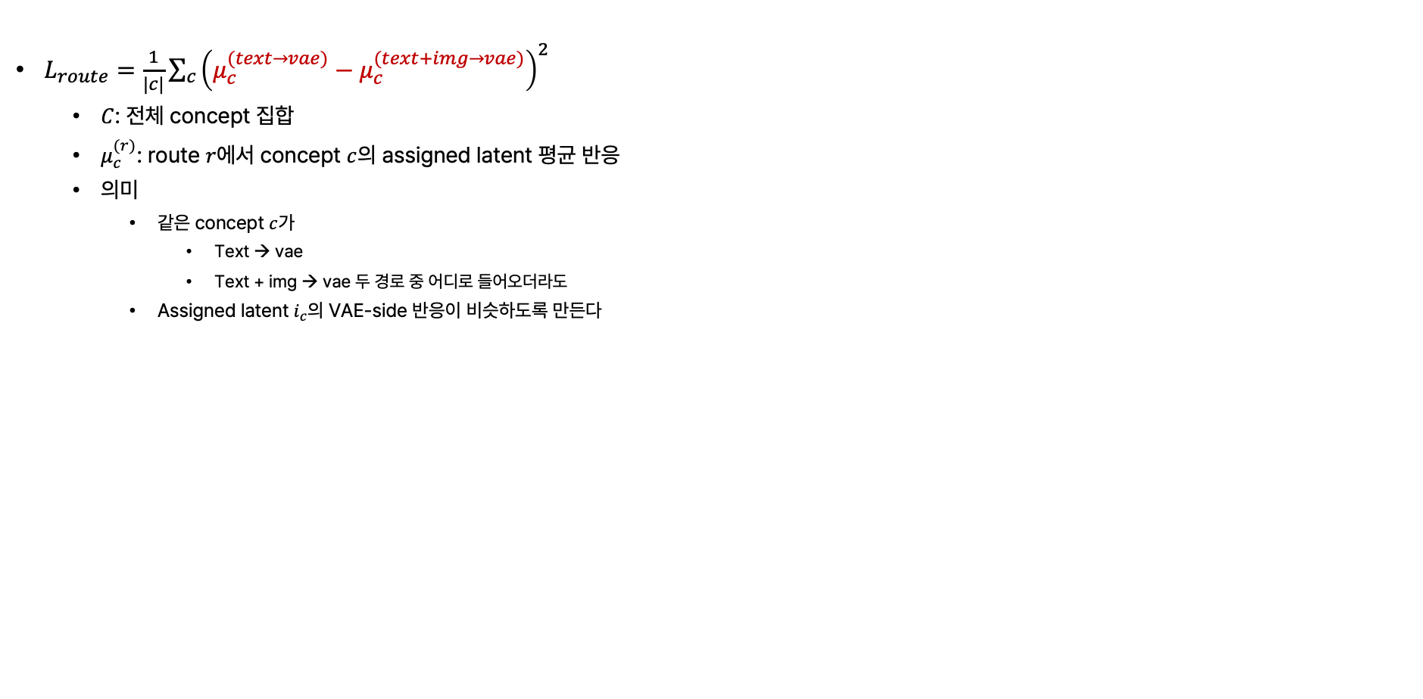
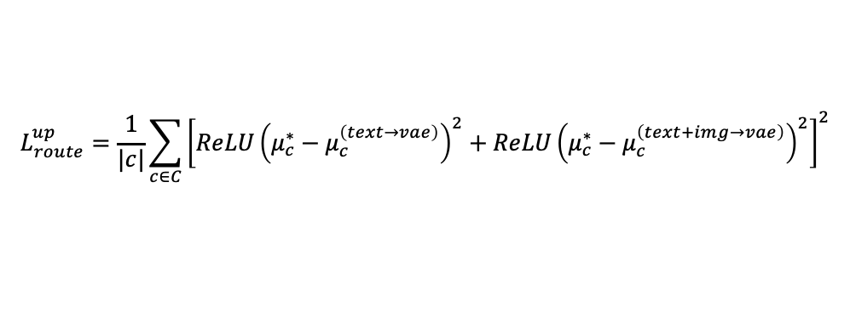
Recap: Loss
$$L=L_{unsup}+βL_{bind}+ηL_{route}$$
Same Sequence (Packed)
[Text Tokens] + [VAE (image) Tokens]
$L_{route}=\frac{1}{|c|}\sum_{c}{{\left(μ_{c}^{(text→vae)}−μ_{c}^{(text+img→vae)}\right)}^{2}}$
$C$: 전체 concept 집합
$μ_{c}^{(r)}$: route $r$에서 concept $c$의 assigned latent 평균 반응
의미
같은 concept $c$가
Text → vae
Text + img → vae 두 경로 중 어디로 들어오더라도
Assigned latent $i_{c}$의 VAE-side 반응이 비슷하도록 만든다
X 28
[Text Tokens]
[VAE (image) Tokens]
(Understanding)
$$W^{Q_und}, W^{K_und}, W^{V_und}$$
(Generation)
$$W^{Q_gen}, W^{K_gen}, W^{V_gen}$$
Text Q, K, V
VAE Q, K, V
Self-Attention
(Understanding)
$${FFN}^{und}$$
(Generation)
$${FFN}^{gen}$$
→ 둘 다 낮아질 수 있는 문제?
$$x$$
$$μ_{c}^{∗}=stopgrad\left(max\left[μ_{c}^{\left(text→vae\right)}, μ_{c}^{\left(text+img→vae\right)}\right]\right)$$
$$W_{enc}$$
$$L_{route}^{up}=\frac{1}{|c|}\sum_{c∈C}{{\left[ReLU{\left(μ_{c}^{∗}−μ_{c}^{\left(text→vae\right)}\right)}^{2}+ReLU{\left(μ_{c}^{∗}−μ_{c}^{\left(text+img→vae\right)}\right)}^{2}\right]}^{2}}$$
$$z∈ℝ^{114688}$$
$$W_{dec}$$
$$\hat{x}$$

Slide 6
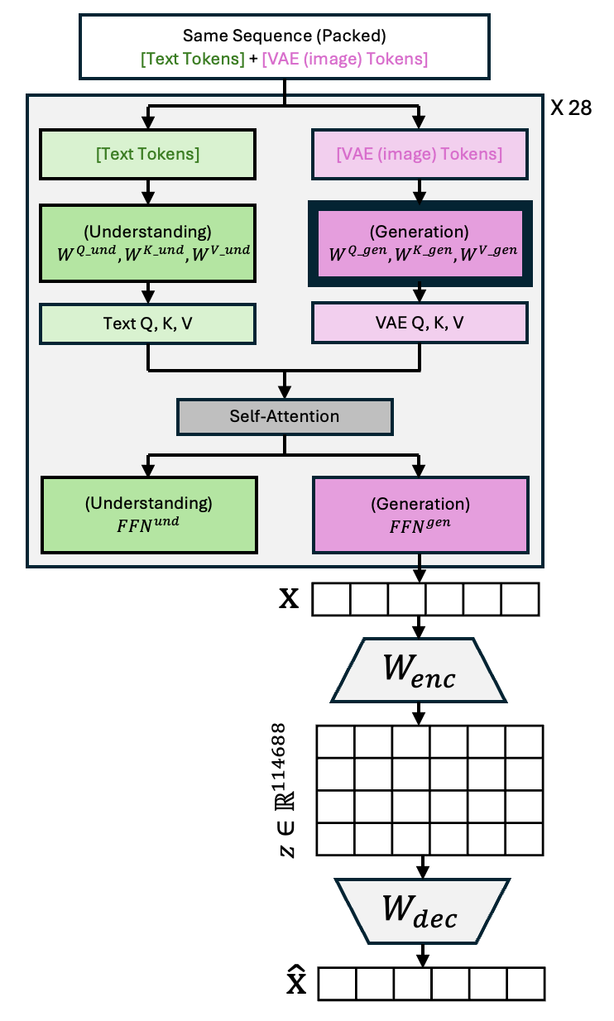

Experiment (0) Settings
[ Collecting ]
[ Train ]
[ Test ]
UnlearnCanvas
20 object classes
× class당 80 anchor prompts
× (51 style postfix + 1 base prompt)
= 83,200
Took 10 hours to collect 1600 object class prompts
Less than 2h
(10 epochs)
A dog wearing aviator goggles piloting an airplane
A dachshund stretched out like a limousine
A poodle with an elaborate hairstyle as a florist
A dog astronaut floating in space with a bone-shaped spaceship
A beagle detective with a magnifying glass
An image of Dogs in {theme 1} style.
An image of Dogs in {theme 2} style.
An image of Dogs in {theme 3} style.
An image of Dogs in {theme 4} style.
An image of Dogs in {theme 5} style.
$$L$$
$$=L_{unsup}$$
$$+βL_{bind}$$
$$+ηL_{route}$$
x 0

Slide 7
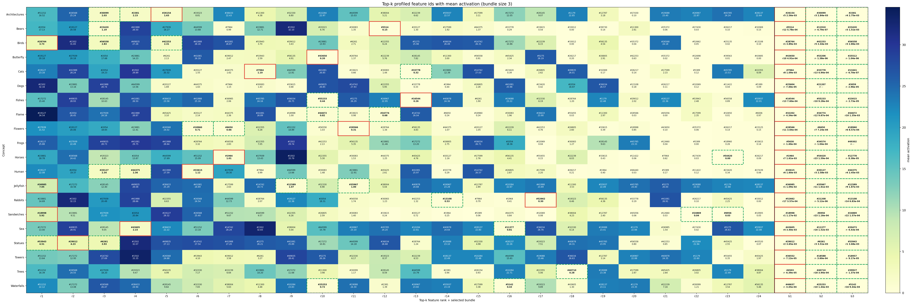
Experiments (0) Settings – Collected Results

Slide 8
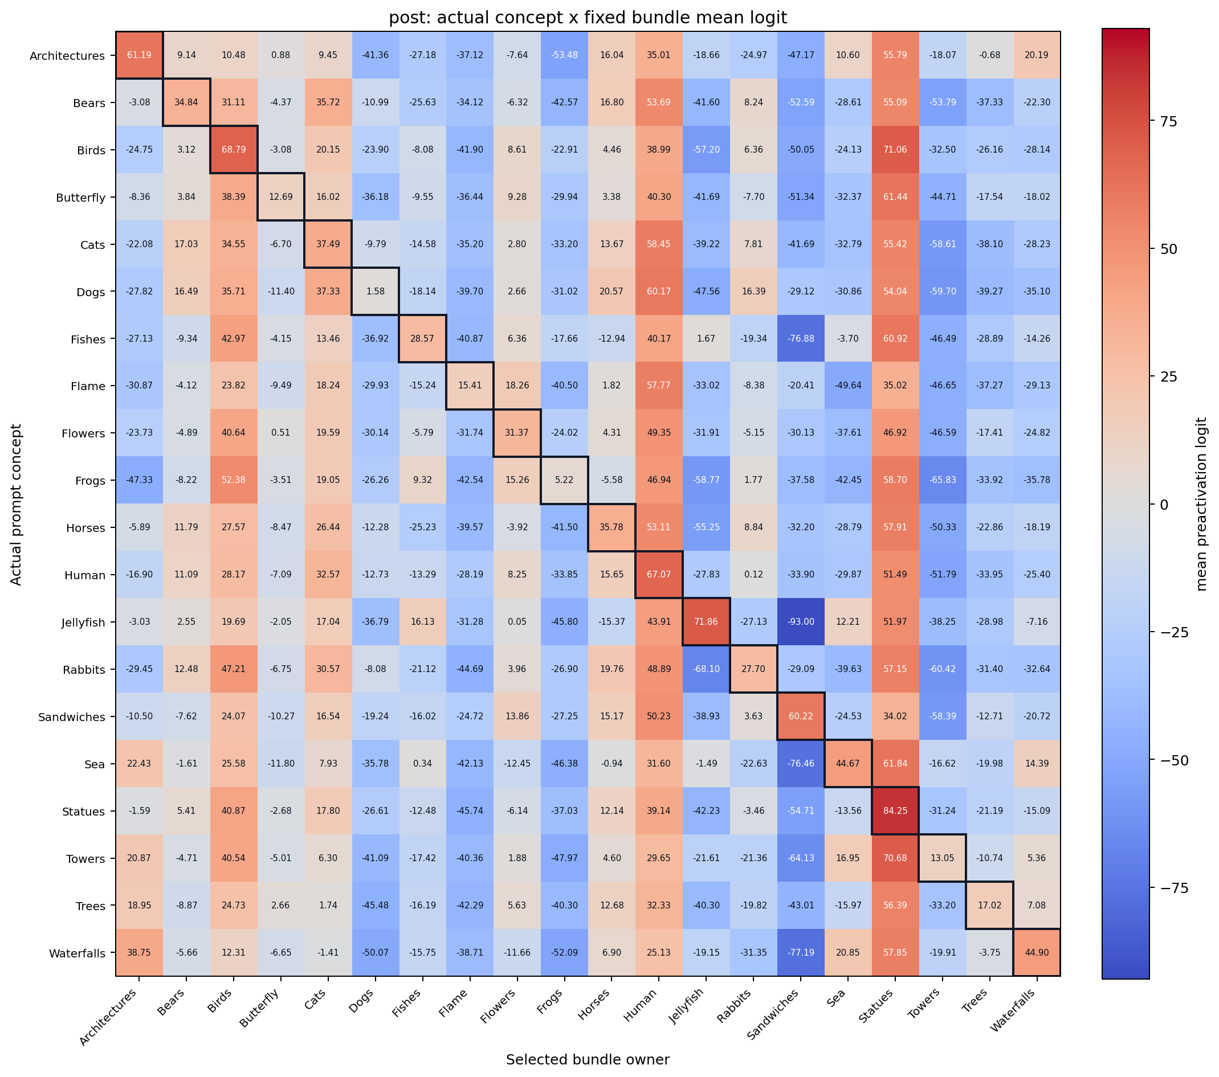
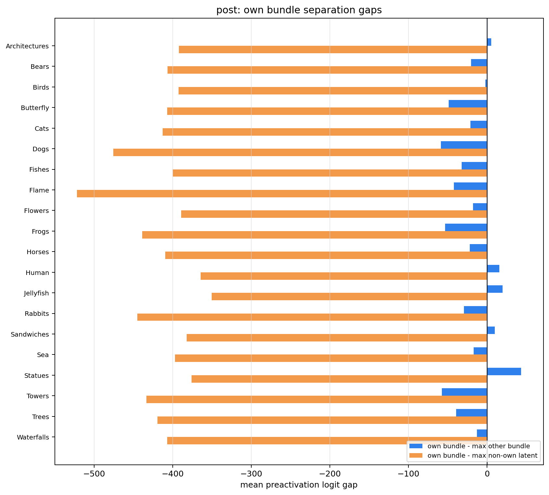
Experiments (1) fixed 3 bundles
Common 제거 없이 3개의 bundle을 고정하여, 그 3개의 activation 값이 높아지도록 함
어떤 concept prompt에서 측정했는가
어떤 concept에 배정된 latent bundle을 보고 있는가

Slide 9
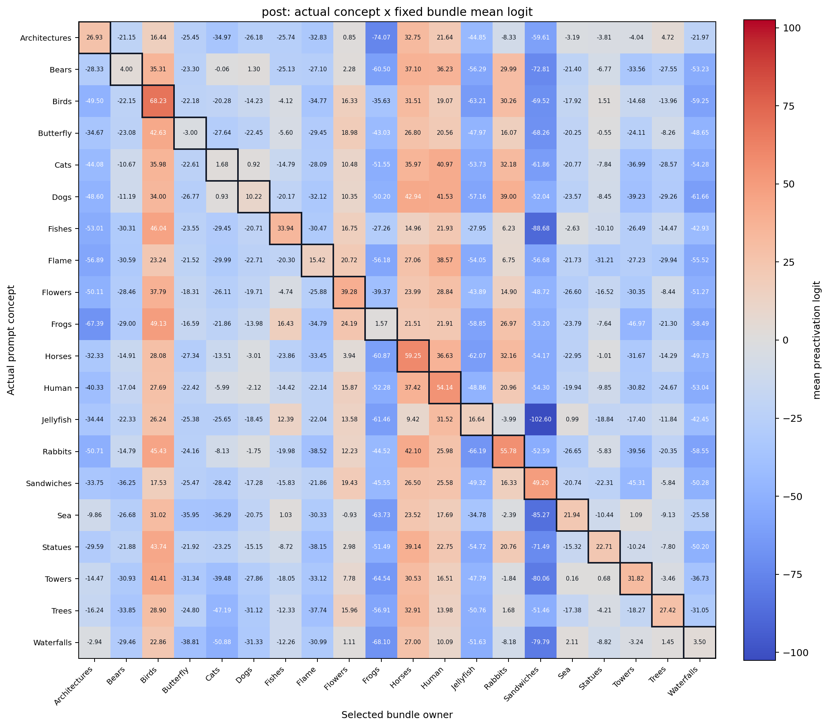
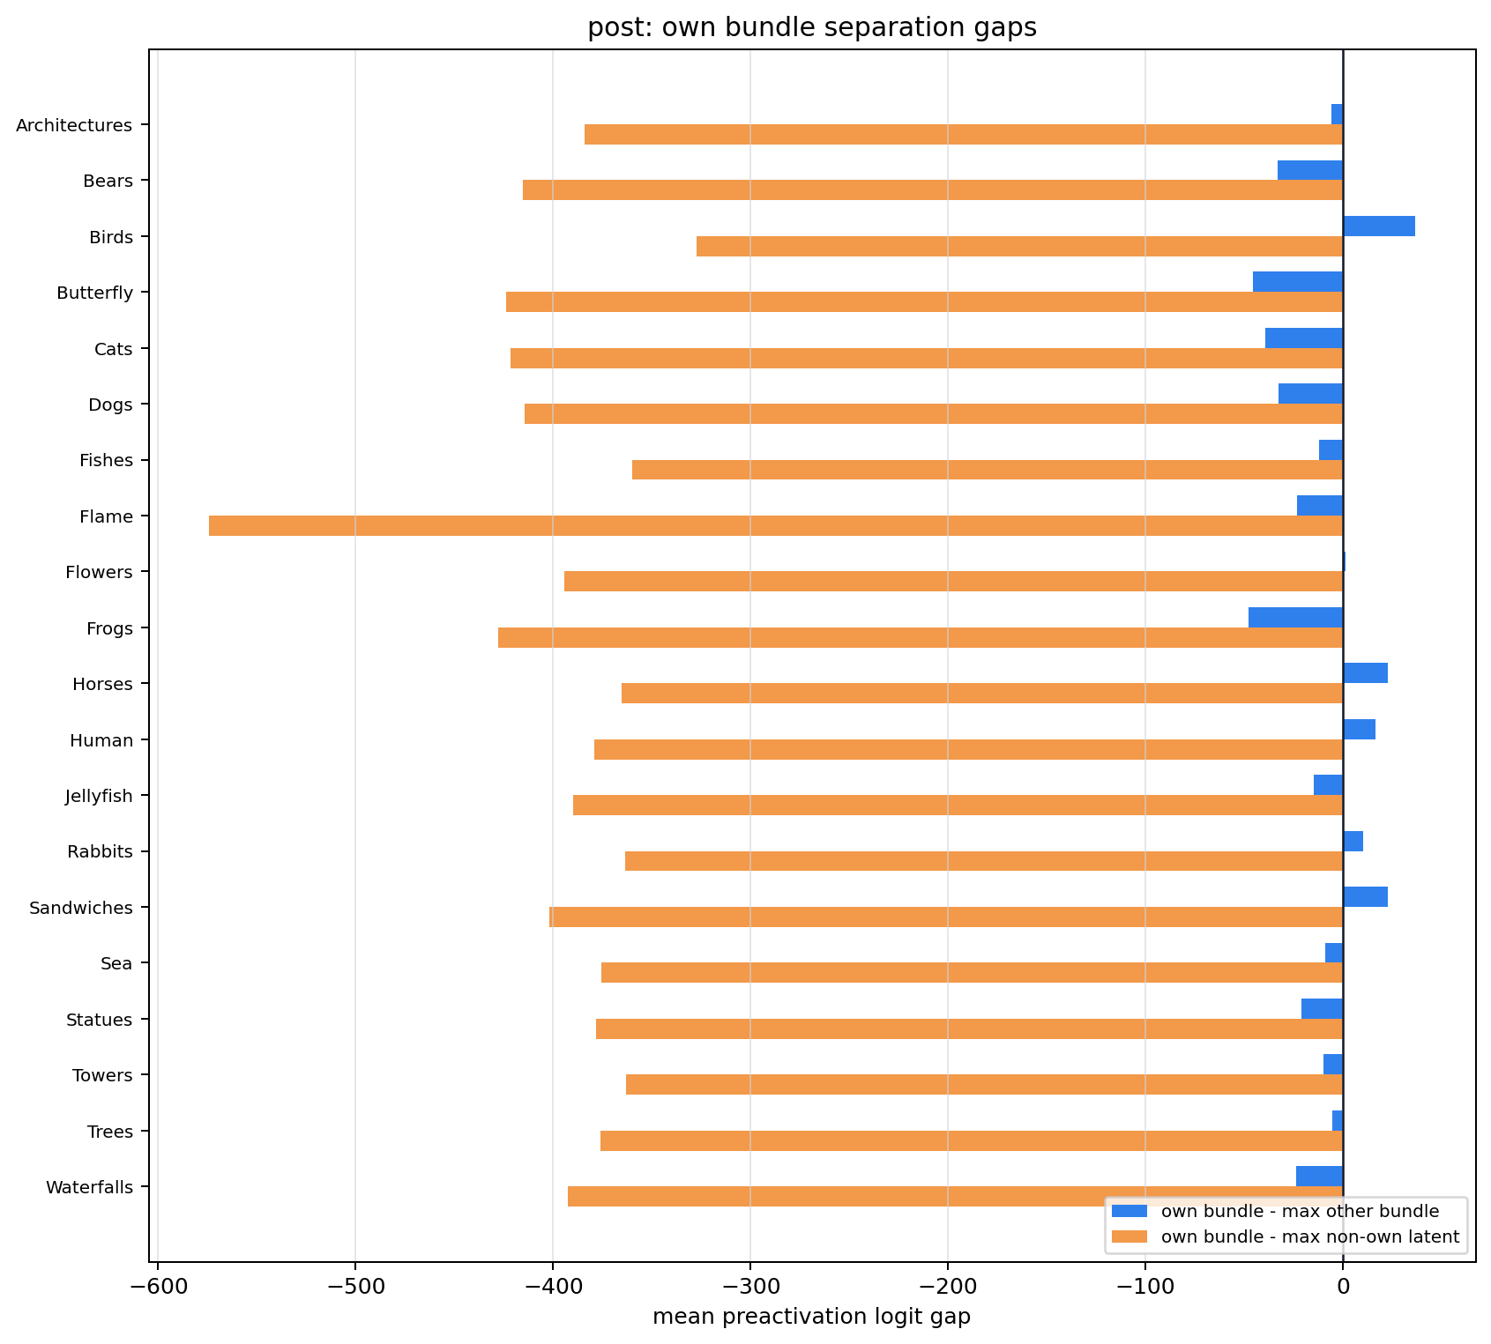
Experiments (2) safe SAEmnesia top1
strong-ish:
Birds +36.7
Horses +22.6
Sandwiches +22.7
mid:
Architectures -5.8
Trees -5.5
Sea -9.1
Towers -9.6
Fishes -12.1
Jellyfish -14.9
bad:
Statues -21.0
Flame -23.2
Waterfalls -23.5
Dogs -32.7
Bears -33.1
Cats -39.3
Butterfly -45.6
Frogs -47.6
usable/weak:
Human +16.7
Rabbits +10.4
Flowers +1.5
Common 제거 후 → top1을 선택하여 activation이 높아지도록 함
어떤 concept prompt에서 측정했는가
어떤 concept에 배정된 latent bundle을 보고 있는가

Slide 10
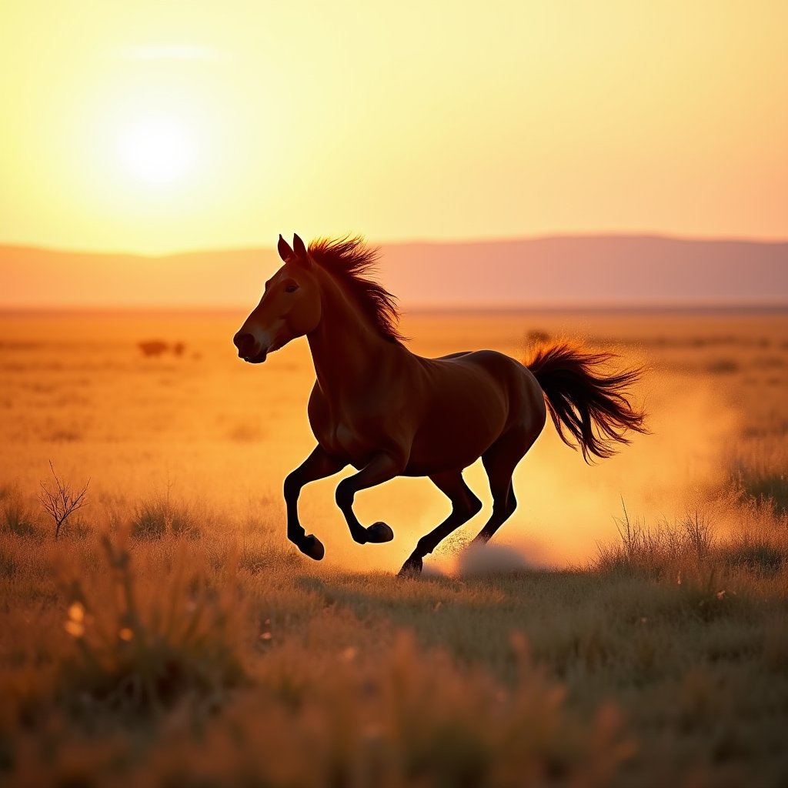

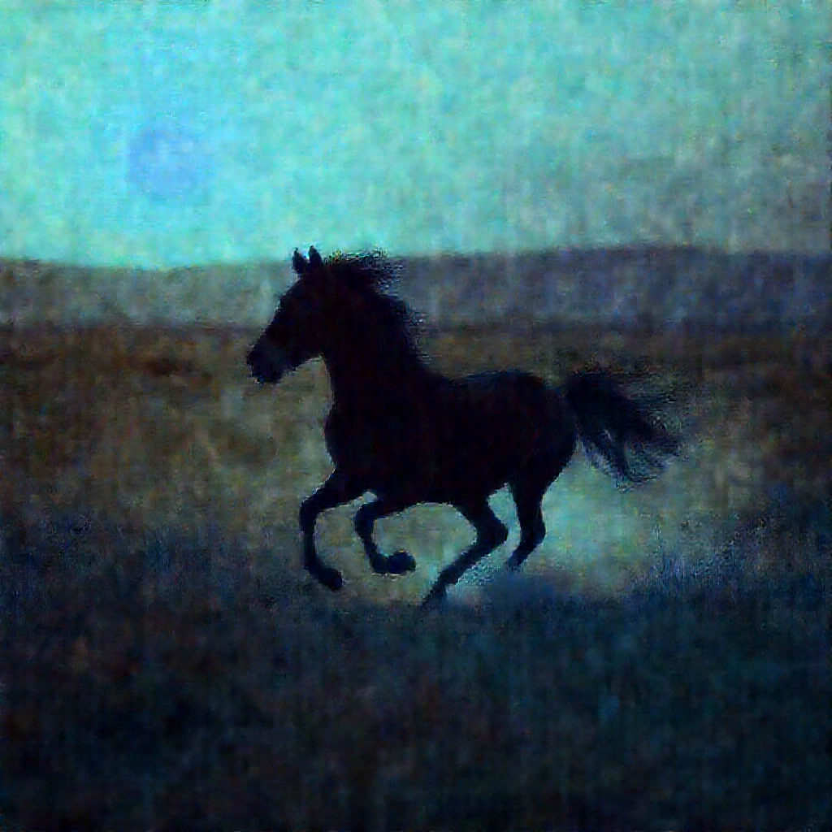
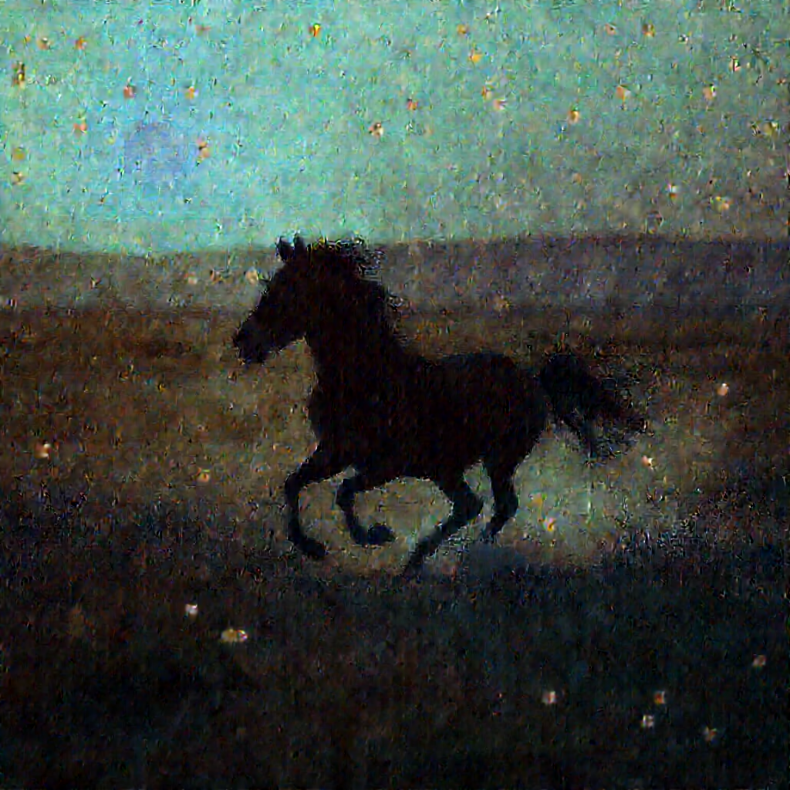
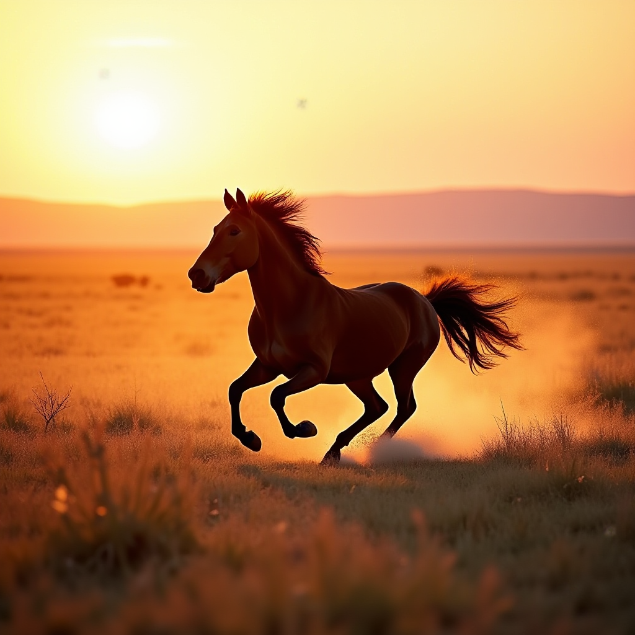
Experiments (2) safe SAEmnesia top1
strong-ish:
Birds +36.7
Horses +22.6
Sandwiches +22.7
mid:
Architectures -5.8
Trees -5.5
Sea -9.1
Towers -9.6
Fishes -12.1
Jellyfish -14.9
bad:
Statues -21.0
Flame -23.2
Waterfalls -23.5
Dogs -32.7
Bears -33.1
Cats -39.3
Butterfly -45.6
Frogs -47.6
usable/weak:
Human +16.7
Rabbits +10.4
Flowers +1.5
Generation Results
Problem
하나의 layer (24) 에서만 intervention
Timestep
수집: late → early/mid
적용: late → early/mid
Activation zero-out 말고 direction subtraction
Target objec에서 방향 벡터 d를 구함
Hidden state에서 그 방향을 직접 빼줌
baseline
top1
top10
top100
random100

Slide 11
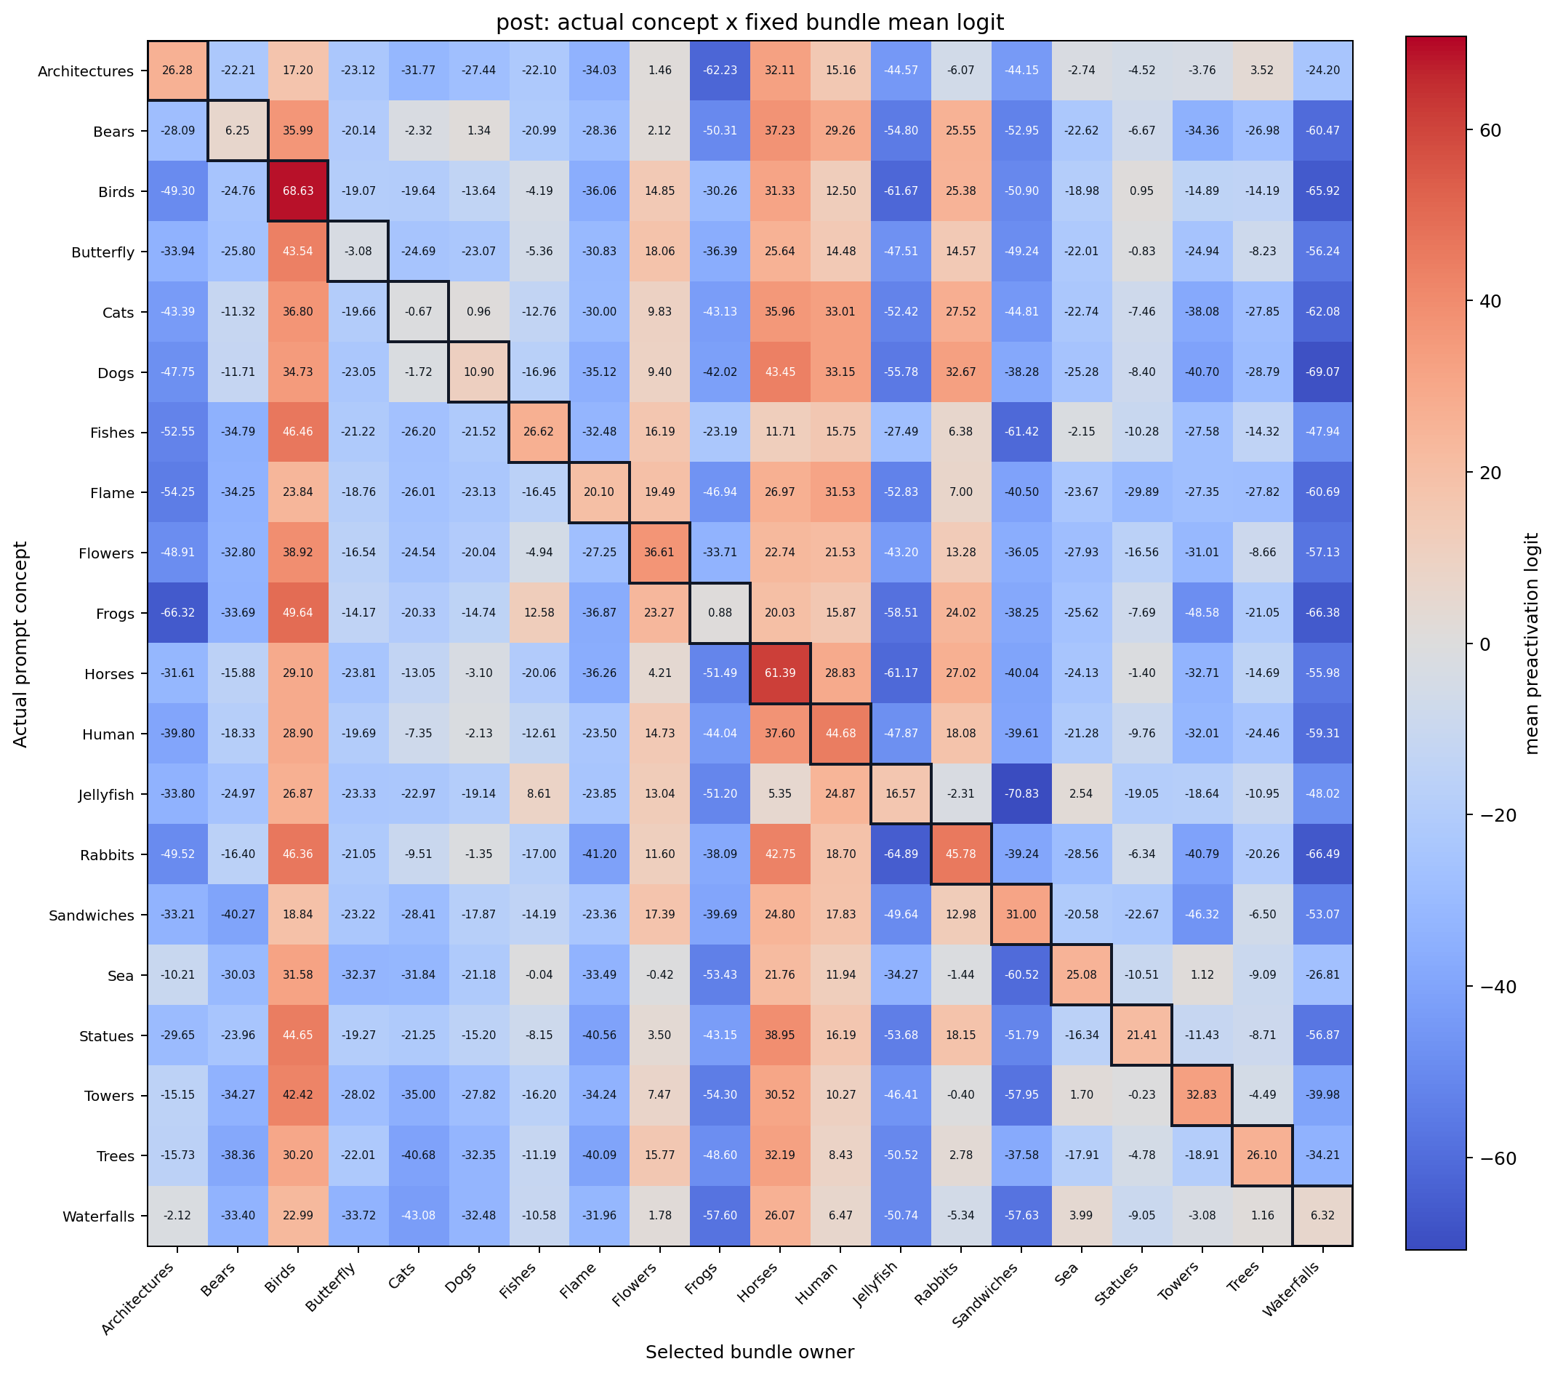
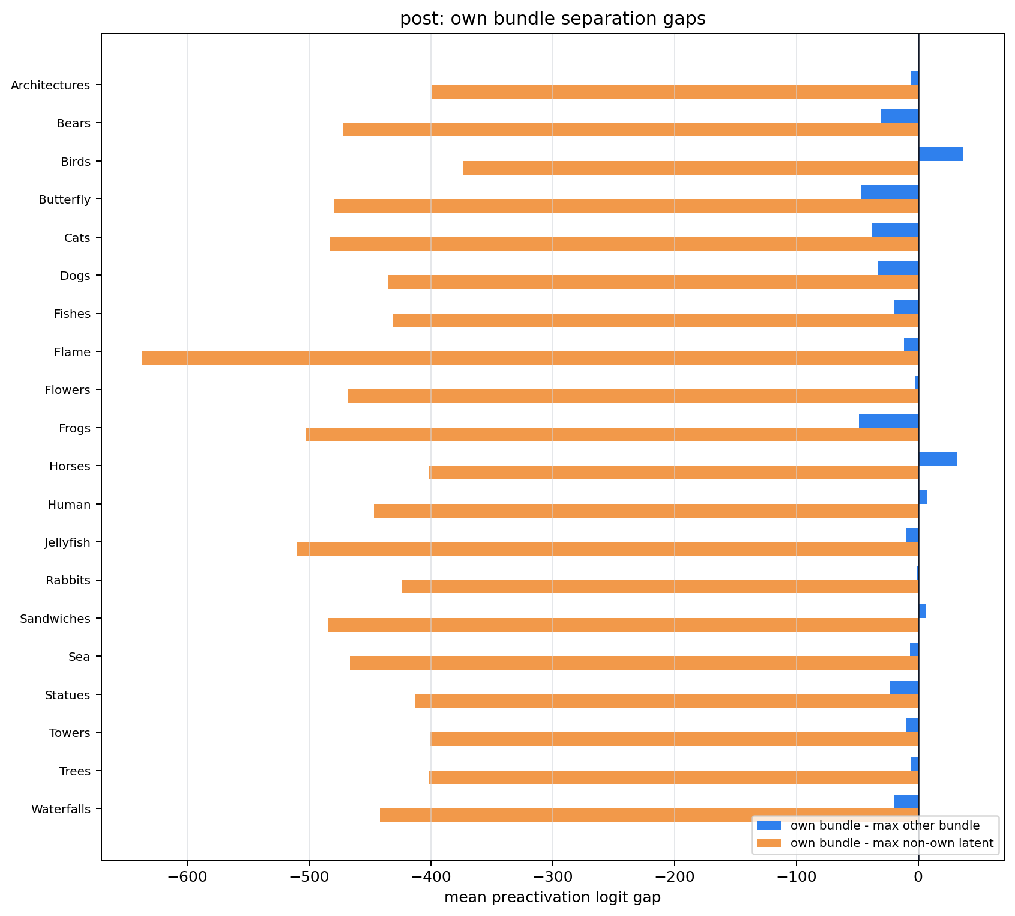
Experiments (3) safe SAEmnesia top3
Common 제거 후 → top3를 선택하여 activation이 높아지도록 함
어떤 concept prompt에서 측정했는가
어떤 concept에 배정된 latent bundle을 보고 있는가

Slide 12

Next Step Idea?
Score analysis
common latent 제거
concept별 candidate pool top10 생성
$L=L_{unsup}+βL_{bind}+ηL_{route}$ 학습
pool 안 latent들의 max activation을 concept에 맞게 올림
특정 latent 하나에 강제로 몰지 않음
post diagnostics:
각 concept pool 안에서 own - max_other 기준으로 다시 ranking
intervention:
ex. k=1,3,5

Slide 13
Generalization
적용가능성/ 기준
Gen-side token/latent 분리 가능한가?
Text와 shared context에서 만나나?
Gen-side에만 hook-intervention 가능한가?
출시 순서 별 모델 및 적용가능성 판단
Model | 적용 가능성 | Github | 논문 | Citations | Release Date | Type
Transfusion | △ | O | Transfusion: Predict the Next Token and Diffuse Images with One Multi-Modal Model | 496 | 2024-08-20 | C-1
Show-o | △ | O | Show-o: One Single Transformer to Unify Multimodal Understanding and Generation | 631 | 2024-08-22 | C-1
MonoFormer | △ | O | MonoFormer: One Transformer for Both Diffusion and Autoregression | 50 | 2024-09-24 | C-1
JanusFlow | △ |  | JanusFlow: Harmonizing Autoregression and Rectified Flow for Unified Multimodal Understanding and Generation | 198 | 2024-11-12 | C-2
LMFusion | △ |  | LMFusion: Adapting Pretrained Language Models for Multimodal Generation | 27 | 2024-12-19 | C-1
Nexus-Gen | X |  | Nexus-Gen: Unified Image Understanding, Generation, and Editing via Prefilled Autoregression in Shared Embedding Space | 4 | 2025-04-30 | B-related
Mogao | O |  | Mogao: An Omni Foundation Model for Interleaved Multi-Modal Generation | 71 | 2025-05-08 | C-2
BAGEL | O | O | Emerging Properties in Unified Multimodal Pretraining | 486 | 2025-05-20 | C-2

Slide 14
Generalization
출시 순서 별 모델 및 적용가능성 판단
Model | 적용 가능성 | Github | 논문 | Citations | Release Date | Type
OpenUni | X |  | OpenUni: A Simple Baseline for Unified Multimodal Understanding and Generation | 22 | 2025-05-29 | B-related
Show-o2 | △ |  | Show-o2: Improved Native Unified Multimodal Models | 132 | 2025-06-18 | B-related
LightFusion | O |  | LightFusion: A Light-weighted, Double Fusion Framework for Unified Multimodal Understanding and Generation | 8 | 2025-10-27 | C-2-like
HBridge | X |  | HBridge: H-Shape Bridging of Heterogeneous Experts for Unified Multimodal Understanding and Generation | 2 | 2025-11-25 | C-2-like
TUNA | △ |  | TUNA: Taming Unified Visual Representations for Native Unified Multimodal Models | 13 | 2025-12-01 | C-1-like
EMMA | X | O | EMMA: Efficient Multimodal Understanding, Generation, and Editing with a Unified Architecture | 4 | 2025-12-04 | C-2-like
InternVL-U | X |  | InternVL-U: Democratizing Unified Multimodal Models for Understanding, Reasoning, Generation and Editing | 2 | 2026-03-10 | adjacent

Slide 15
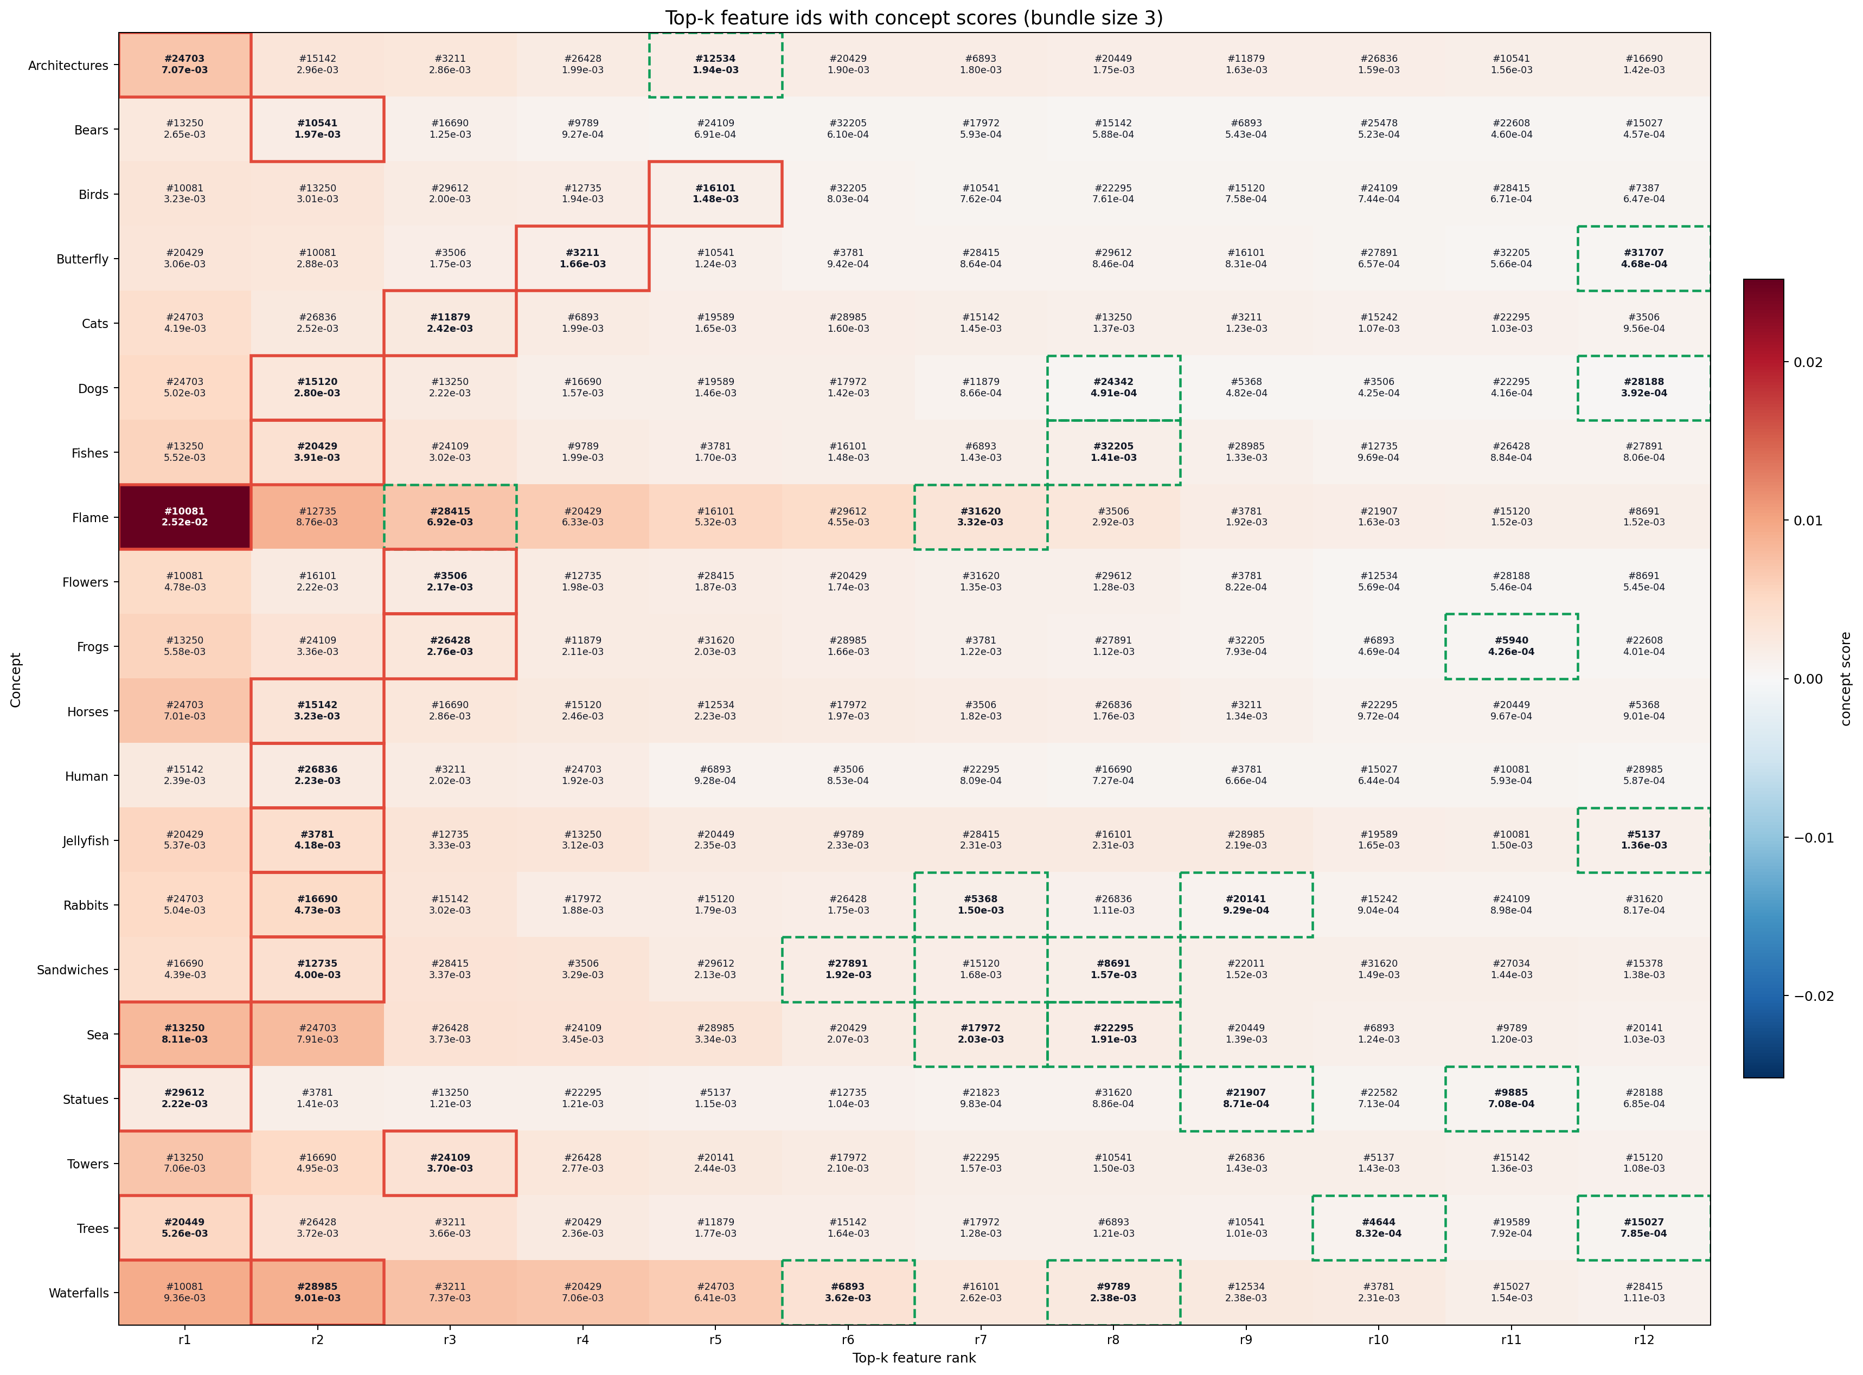
Generalization (2) Show-o

Slide 16
Extension to Image Editing
T2I
UnlearnCanvas
I2P
EMMA
HUB
I2I
MagicBrush
I2EBench
Pico-banana-400k

